Slide 1
ING
SonarQube-Rule-Customization
By
Prashant Gaikwad/Mahendran S
July 16, 2020
1

Slide 2
Overview of SonarQube
SonarQube (formerly Sonar) is an open-source platform developed by SonarSource for continuous inspection of code quality to perform automatic reviews with static analysis of code to detect bugs, code smells, and security vulnerabilities on 20+ programming languages.
Each category has a corresponding number of issues or a percentage value.
Issues can have one of five different severity levels: blocker, critical, major, minor and info.
Just in front of the project name is an icon that displays the Quality Gate status – passed (green) or failed (red).
SonarQube offers reports on duplicated code, coding standards, unit tests, code coverage, code complexity, comments, bugs, and security vulnerabilities.
SonarQube provides fully automated analysis and integration with Maven, Ant, Gradle, MSBuild and continuous integration tools (Atlassian Bamboo, Jenkins, Hudson, etc.).
SonarQube integrates with Eclipse, Visual Studio, and IntelliJ IDEA development environments through the SonarLint plug-ins, and also integrates with external tools like LDAP, Active Directory, GitHub, and others.
SonarQube is expandable with the use of plug-ins.

Slide 3
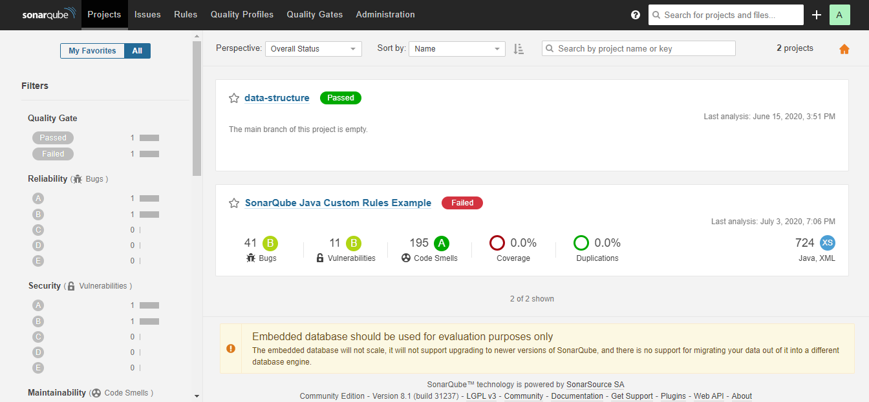
SonarQube Report

Slide 4
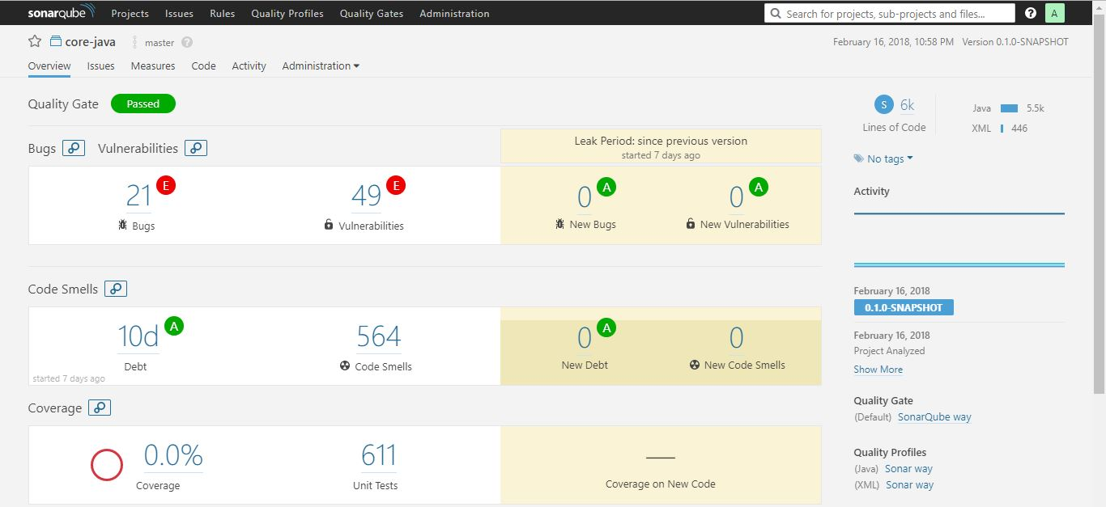
SonarQube Report

Slide 5
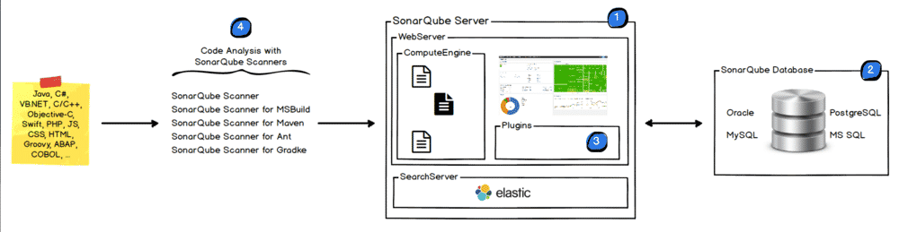
How Sonar Works ?

Slide 6
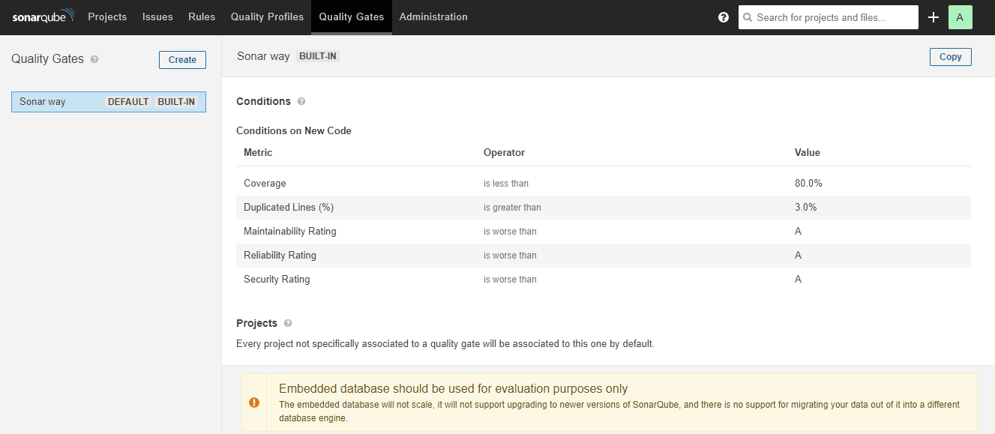
SonarQube Quality Gate

Slide 7
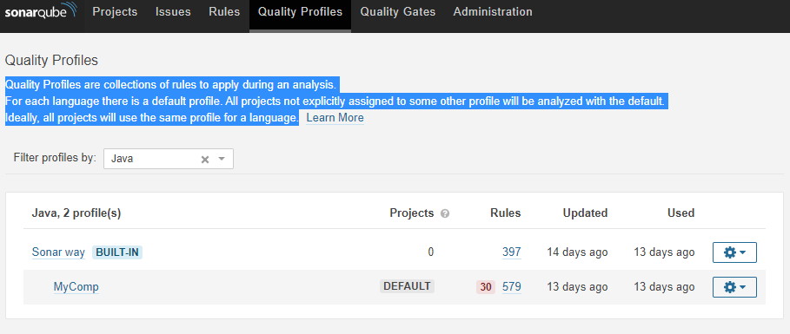
Quality Profiles
Quality Profiles are collections of rules to apply during an analysis.

Slide 8
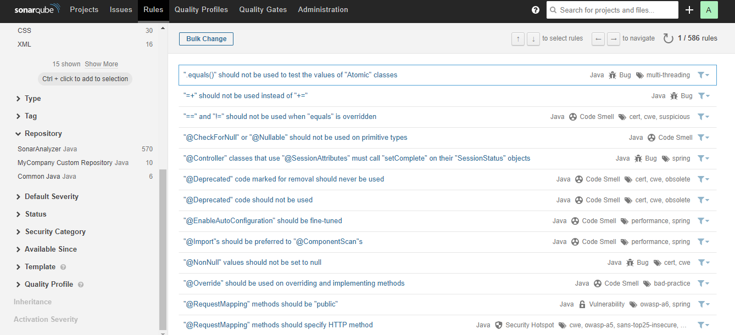
SonarQube Rules

Slide 9
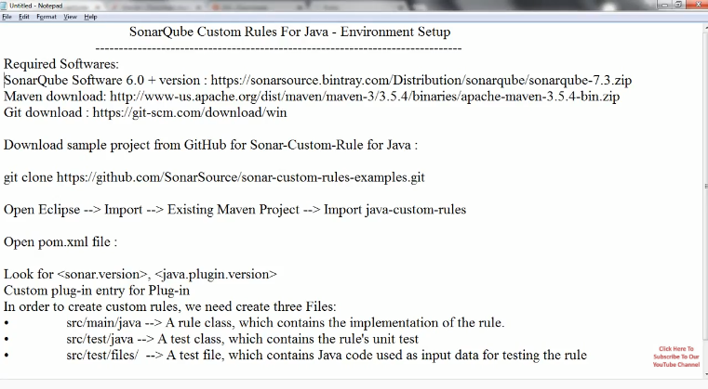
Writing Custom Rules For Java in SonarQube

Slide 10
To create our first custom rule
3.In package org.sonar.samples.java.checks of /src/main/java, create a new class called MyFirstCustomCheck extending class org.sonar.plugins.java.api.IssuableSubscriptionVisitor provided by the Java Plugin API. Then, replace the content of the nodesToVisit() method with the content from the following code snippet (you may have to import com.google.common.collect.ImmutableList). This file will be described when dealing with implementation of the rule!
MyFirstCustomCheck.java
package org.sonar.samples.java.checks;
import com.google.common.collect.ImmutableList;
import org.sonar.plugins.java.api.IssuableSubscriptionVisitor;
import org.sonar.plugins.java.api.tree.Tree.Kind;
import java.util.List;
@Rule(key = "MyFirstCustomRule")
public class MyFirstCustomCheck extends IssuableSubscriptionVisitor {
@Override
public List<Kind> nodesToVisit() {
return ImmutableList.of();
}
}

Slide 11
To create our first custom rule
1.In folder /src/test/files, create a new empty file named MyFirstCustomCheck.java, and copy-paste the content of the following code snippet.
MyFirstCustomCheck.java
1
2
3
class MyClass {
}

Slide 12
To create our first custom rule
2.In package org.sonar.samples.java.checks of /src/test/java, create a new test class called MyFirstCustomCheckTest and copy-paste the content of the following code snippet.
MyFirstCustomCheckTest.java
package org.sonar.samples.java.checks;
import org.junit.Test;
public class MyFirstCustomCheckTest {
@Test
public void test() {
JavaCheckVerifier.verify("src/test/files/MyFirstCustomCheck.java", new MyFirstCustomCheck());
}
}

Slide 13
Build & Deployment
After creating all the relevant files for SonarQube rule customization, build the library using maven or any other build tool.
Copy the jar file from target directory to $HOME\sonarqube-8.1.0.31237\extensions\plugins directory
Start the sonar server by clicking StartSonar under $HOME\sonarqube-8.1.0.31237\bin\windows-x86-64\ directory.
Verify the rule is present in the repository section in sonarqube admin screen.

Slide 14
Sonar Setup Instructions
Sonar Setup installation instructions available.

Slide 15
Demo on SonarQube Rule Customization.
Demo on SonarQube Rule Customization.

